Slide 1
Android 101
Zaki Anwar Hamdani

Slide 2
About Zaki
Java Developer
Has spend over seven years in Banking and Financial Services industry
Passion for learning
Open to new roles in Australia

Slide 3
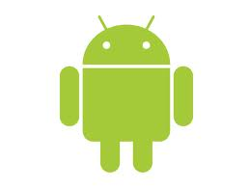
What is Android?
“An automaton that is created from biological materials and resembles a human. Also called humanoid.”
Operating System from Google
Open Source
Linux based
Intended for mobile computing platforms
It is the world's most widely used Smart Phone platform since Q4 2010

Slide 4
What It is NOT
Not J2ME extension
Simply an Application Layer
A mobile phone handset
Google’s answer to iPhone !!!

Slide 5
Before Android
Embedded Programming
Hardware Dependant
J2ME
Symbian
iOS

Slide 6
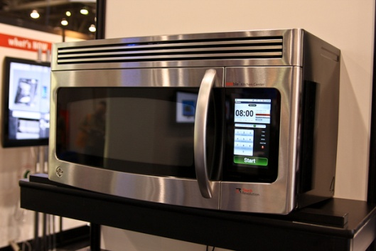
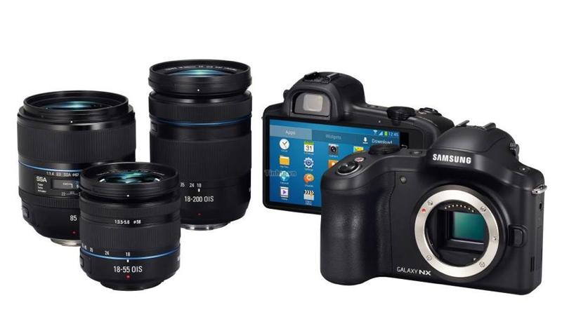
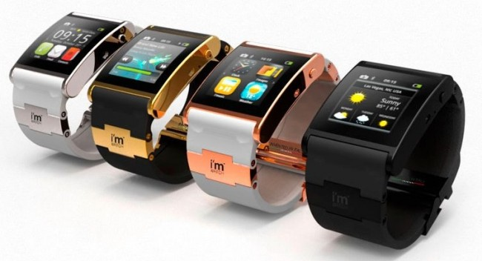
Why Learn it
Newness
Coolness
Googleness
Javaness
Universalness

Slide 7
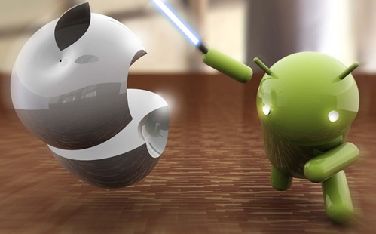
Future of all devices
Android went ahead of Apple in Apr’13 with 51.7% market Share

Slide 8
Android SDK
It’s free
Contains API for App Development
API for telephony like GSM, EDGE, 3G and Location
IPC Message passing
Graphics Library OpenGL ES
Integrated with Eclipse

Slide 9
Love IntelliJ IDEA?
Google will deprecate Eclipse
It recently added full-cycle Android development support in both the free Community Edition and the Ultimate edition
The IDE ensures compatibility with the latest Android SDK and offers a smart code editor with completion, quick navigation between code and resources, a graphical debugger, unit testing support using Android Testing Framework, and the ability to run applications in either the emulator or a USB-connected device.
http://developer.android.com/tools/workflow/index.html

Slide 10
Do You need phone?
Not Really
Though little slow, but an emulator that is part of the Android SDK can be used for development.
(Google has earlier distributed free phones to developers fulfilling certain criteria)

Slide 11
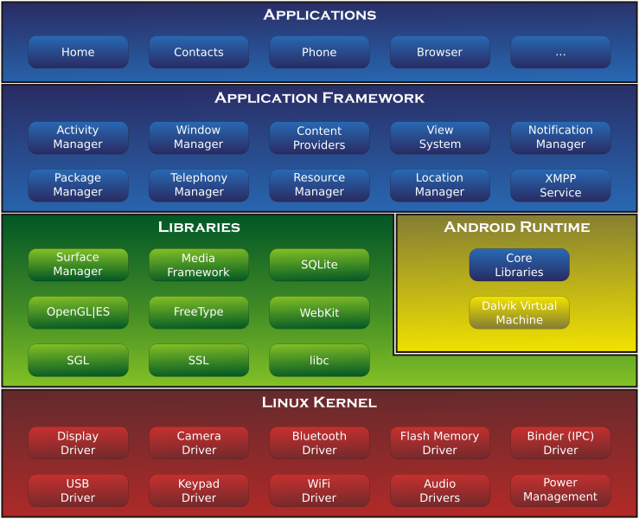
Architecture

Slide 12
Framework Layer
Feature | Role
View System | Used to build an application, including lists, grids, text boxes, buttons, and embedded web browser
Content Provider | Enabling applications to access data from other applications or to share their own data
Resource Manager | Providing access to non-code resources (localized strings, graphics, and layout files)
Notification Manager | Enabling all applications to display customer alerts in the status bar
Activity Manager | Managing the lifecycle of applications and providing a common navigation back stack.

Slide 13
Developer Perspective
Activity
Service
Broadcast Receiver
Content Provider
Intent
AndroidManifest

Slide 14
Activity
Similar to a Use Case.
Represent one thing (Activity) that user can do.
A typical application may have multiple Activities.
Each Activity extends android.app.Activity class
Each Activity has a window (or view) to draw contents.

Slide 15
Service
No Visual interface
Runs in background
Examples are File Downloading, Playing Music, Call Recording etc

Slide 16
Broadcast Receiver
Extend the class android.content.BroadcastReceiver
It receives and (may) react to broadcast announcements.
For Example, Low Battery, Time zone changed etc.

Slide 17
Content Provider
Used to interchange data between different Applications
This is only way to exchange/transfer data between different Apps, that is, no shared memory, no shared files etc

Slide 18
Intent
An Intent to start either an Activity, Service or Broadcast Receiver
Analogous to form submission in web applications.

Slide 19
AndroidManifest.xml
Package and Version
SDK
Application
Activities
Permissions

Slide 20
<?xml version="1.0" encoding="utf-8"?>
<manifest xmlns:android="http://schemas.android.com/apk/res/android"
package="org.melbjvm.android"
android:versionCode="1"
android:versionName="1.0" >
<uses-sdk
android:minSdkVersion="8"
android:targetSdkVersion="17" />
<application
android:allowBackup="true"
android:icon="@drawable/ic_launcher"
android:label="@string/app_name"
android:theme="@style/AppTheme" >
<activity
android:name="org.melbjvm.android.MainActivity"
android:label="@string/app_name" >
<intent-filter>
<action android:name="android.intent.action.MAIN" />
<category android:name="android.intent.category.LAUNCHER" />
</intent-filter>
</activity>
</application>
<uses-permission android:name="android.permission.SEND_SMS" />
</manifest>

Slide 21
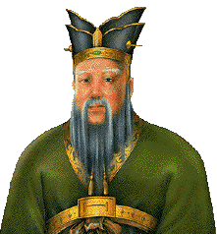
What Next???
Confucius said….
“I hear and I forget,
I see and I remember,
I do and I understand.”
So let us do something……

Slide 22
What we will do
Create simple Android App and run it on Emulator
Run the same on phone
Create and run another app with simple Graphics
Create and run one more app with Web Service

Slide 23
Starting with SDK
Download from
http://developer.android.com/sdk/installing/index.html
It uses Eclipse IDE and its Cool!!!
Start Eclipse, select Workspace

Slide 24
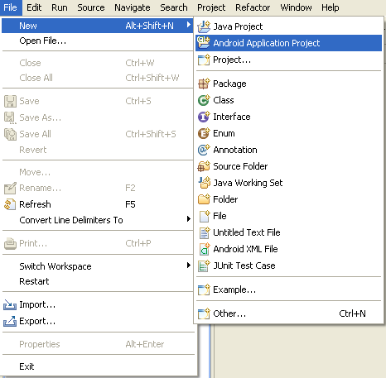
Create Project

Slide 25
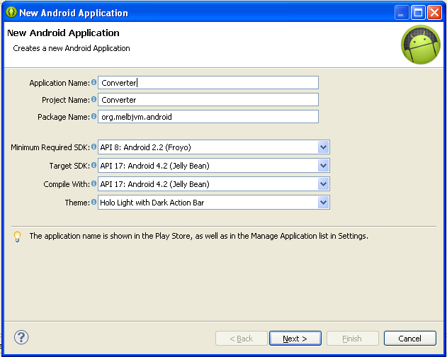

Slide 26
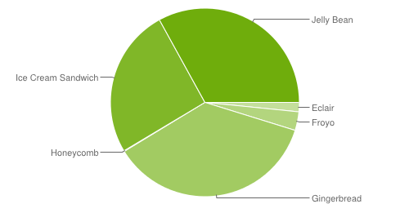
Version

Slide 27
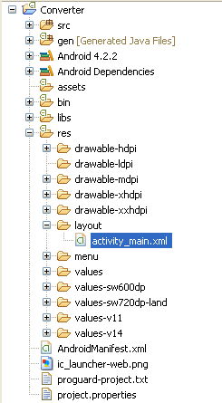

Slide 28
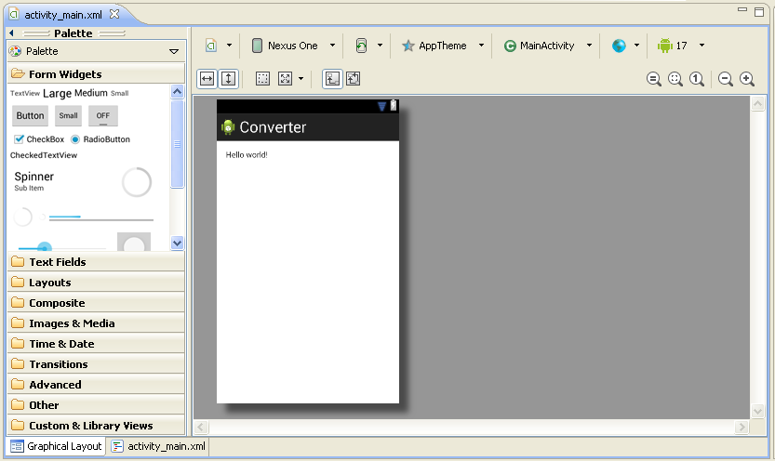

Slide 29
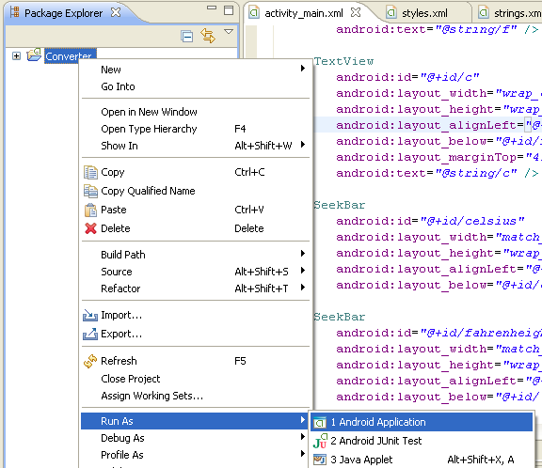

Slide 30
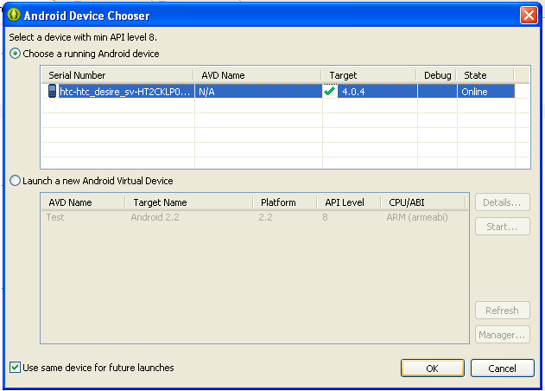

Slide 31
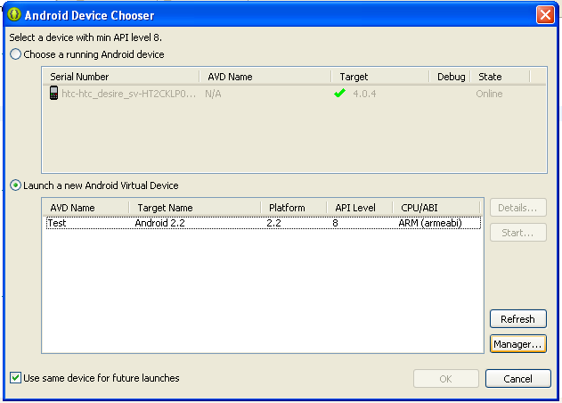

Slide 32
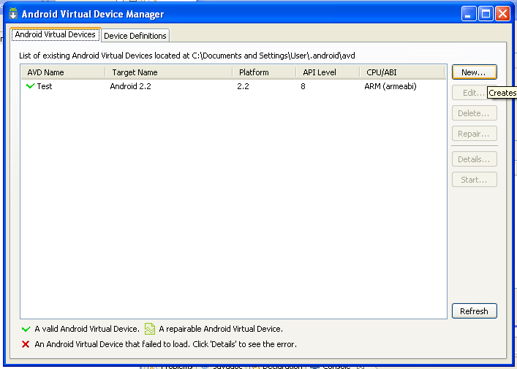

Slide 33
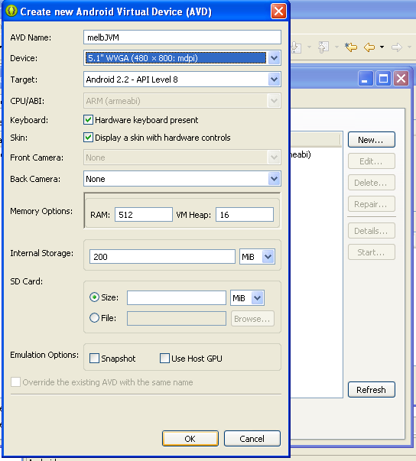

Slide 34
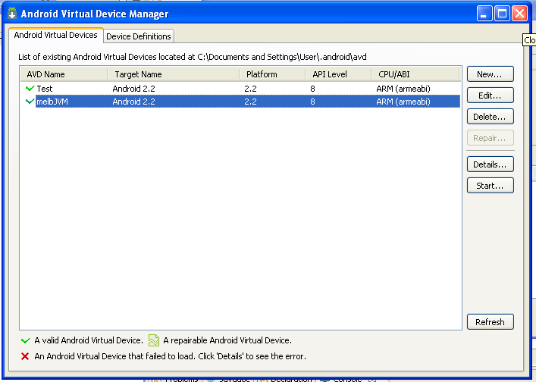

Slide 35
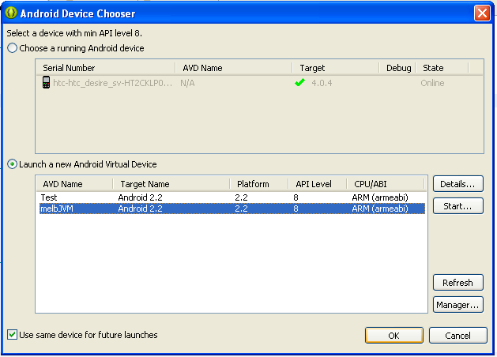

Slide 36
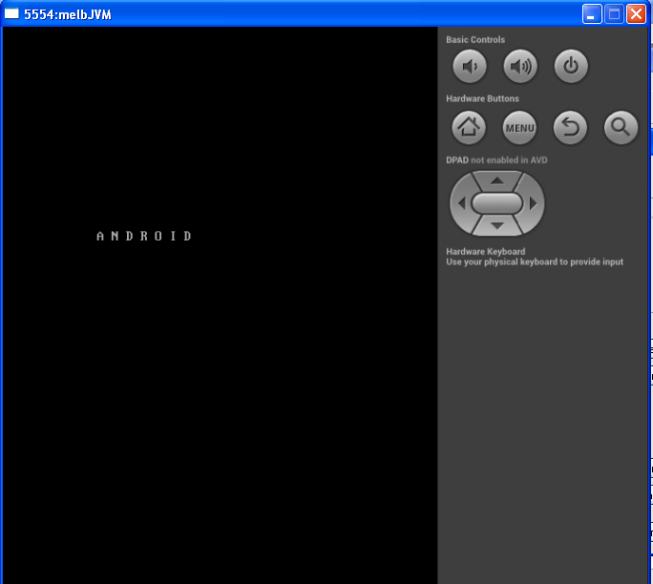

Slide 37
App 2 - Graphics

Slide 38
What’s special?
Layout.xml is not required
Rather a View class (one that extends to android.view.View) can be created.
The overridden onDraw(Canvas) method draws the stuff on screen.
Canvas has multiple methods to draw different elements.

Slide 39
And it is also possible to draw images directly which is much easier
An OnTouchListener is required to address user inputs
Often, view needs to be a Thread to update display continuously

Slide 40
Questions and Answers

Slide 41
References
http://developer.android.com
http://developer.android.com/design/index.html
http://code.google.com/p/apps-for-android/
http://www.kantarworldpanel.com/Global/News/While-Android-Leads-iOS-and-Windows-Are-Growing-At-A-Faster-Pace

